Slide 1
ASSEMBLY

Slide 3
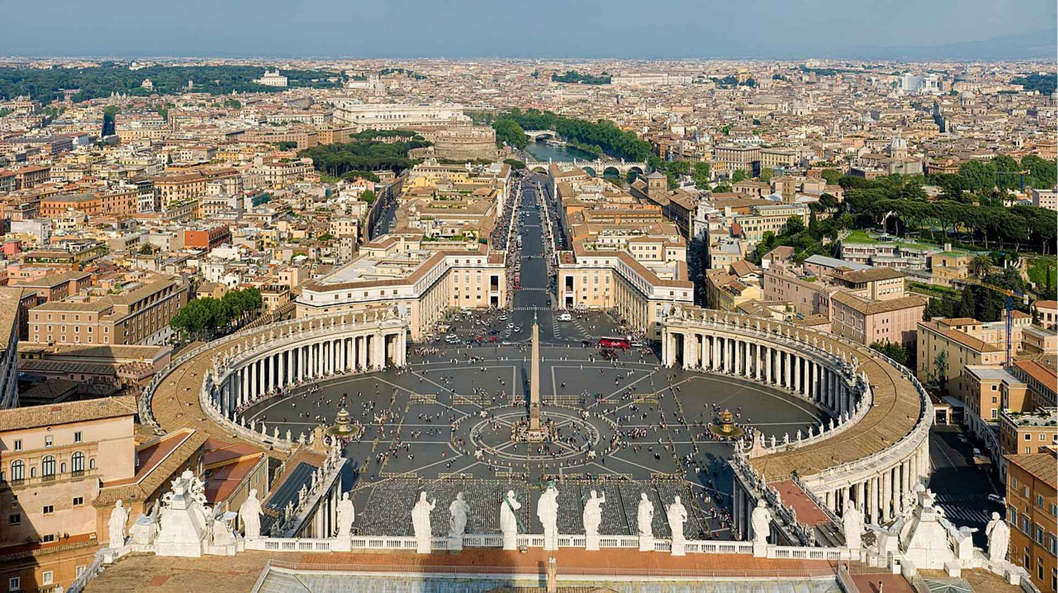

Slide 5
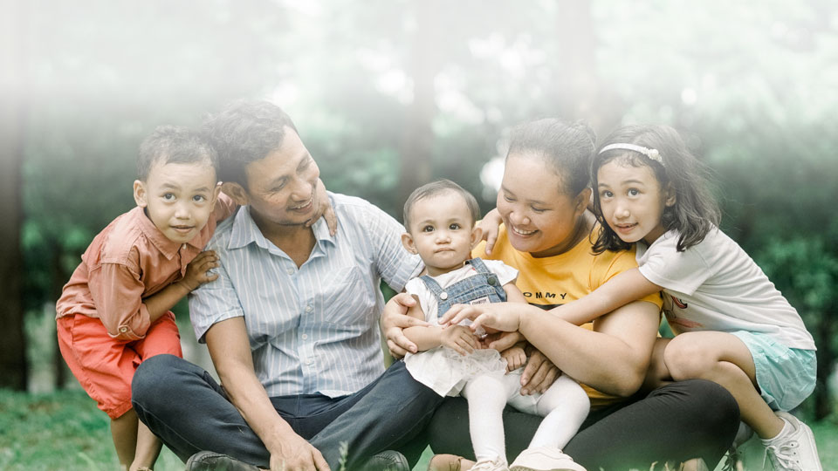
I think my family is special because…

Slide 6
Heavenly Father,
We thank you for the
great gift of families.
Help us to love each other,
just as Christ loves us,
so that we keep on the path to holiness,
and continue to grow in love together.
Lord, help each family
to know that they are special
members of the Church
called to be disciples,
in service of life and peace
and to love one another.
Amen.

Slide 7
ASSEMBLY

